Slide 1

Searching and Ranking Term Project
By: Hao Wu

Slide 2
Goal
Extract the text content, perform preprocessing and content analysis to rank (hierarchical clustering) these pages for similarity.
Visually display the 75 most frequent words.
Use Bubble Chart to visually display each pages freq words.

Slide 3
URL
"Data_Analysis.html" "Data_Mining.html" "Data_Science.html" "Database.html"
"Economics.html" "Mathematics.html" "Statistics.html"
"World_War_One.html" "World_War_Two.html” "Vietnam_War.html"

Slide 4
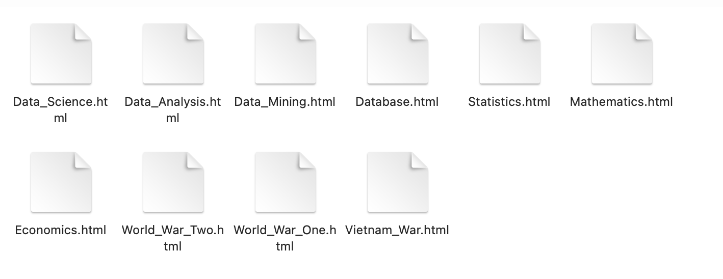
Html files

Slide 5
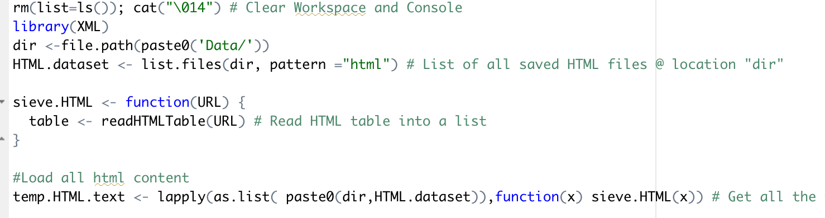
First Step
We need input our URLs content to our R workspace.

Slide 6
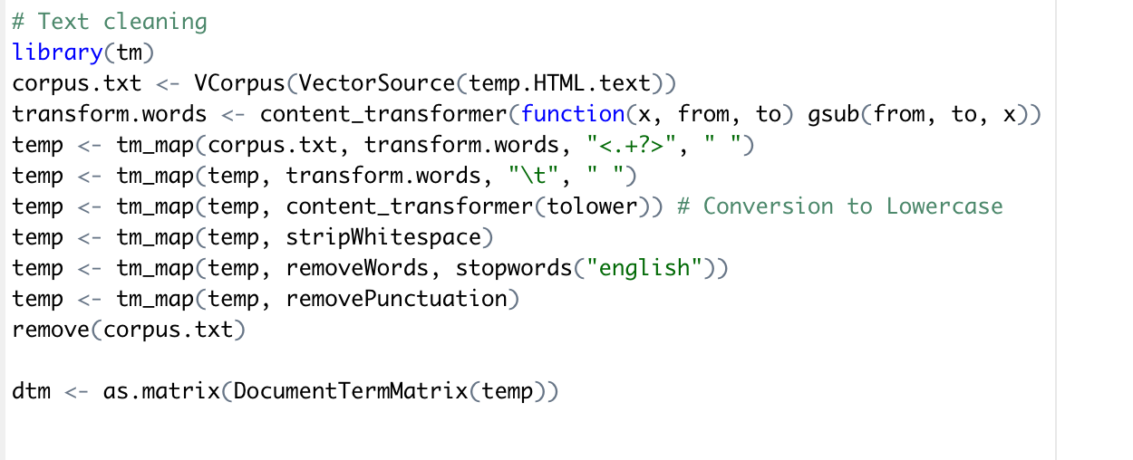
Text preprocessing
In this step, we use tm package to transform our html content into corpus. Then we do txt cleaning.

Slide 7
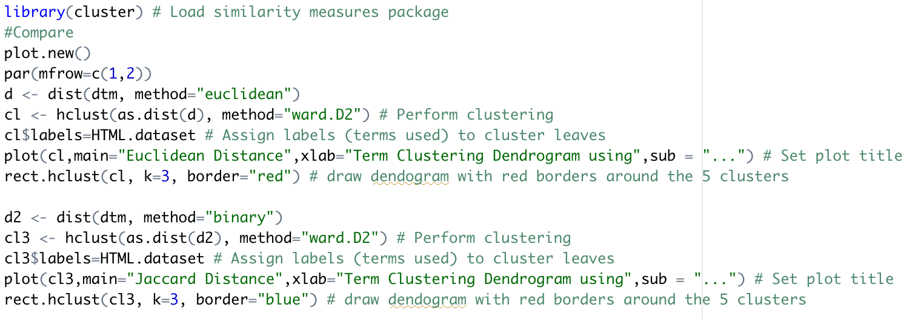
Cluster(Jaccard distance VS Euclidean distance)

Slide 8
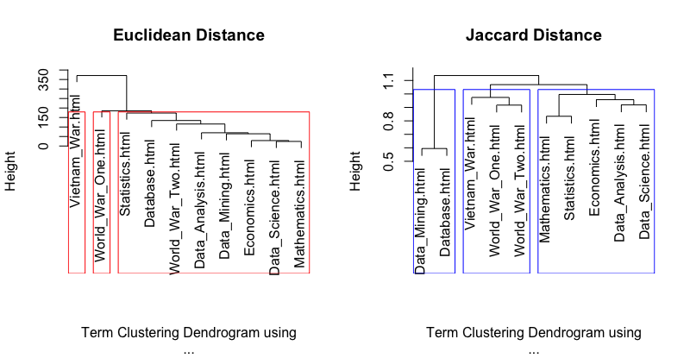
Who is the Winner?
Jaccard Distance show us a better perform on hierarchical clustering .

Slide 9

What is our job?
What we need is to make disorganized data, after we organize and analyze it, into analysis that non-professionals can understand.
We need tidy it up and do visualization.

Slide 10
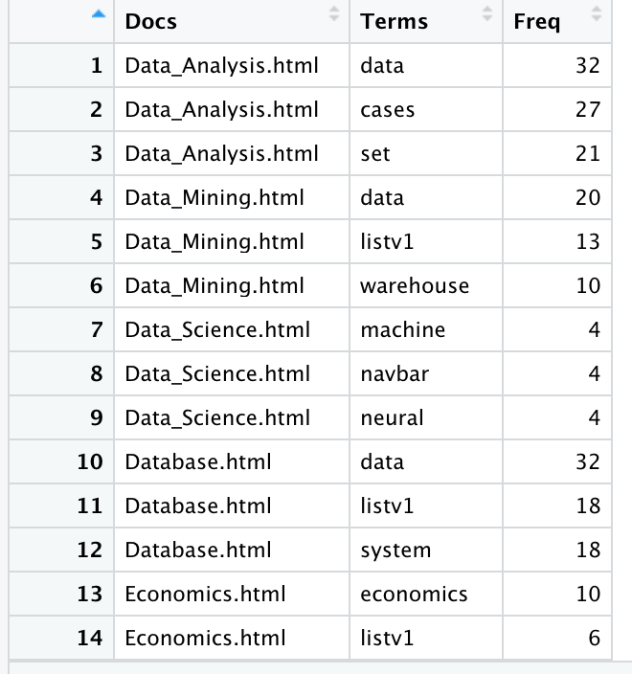
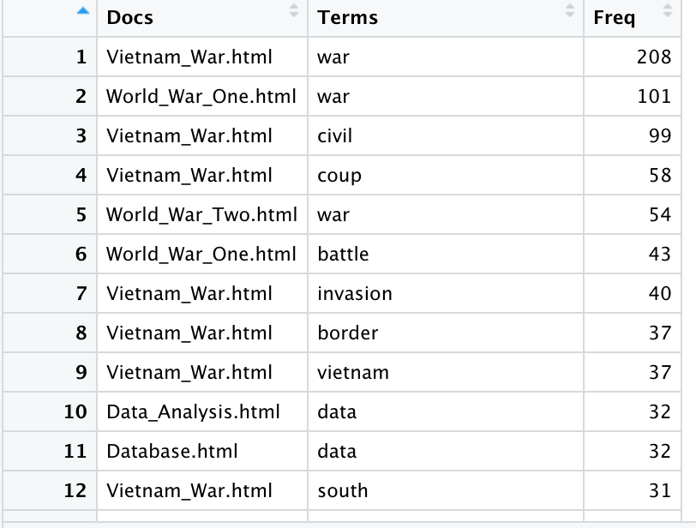
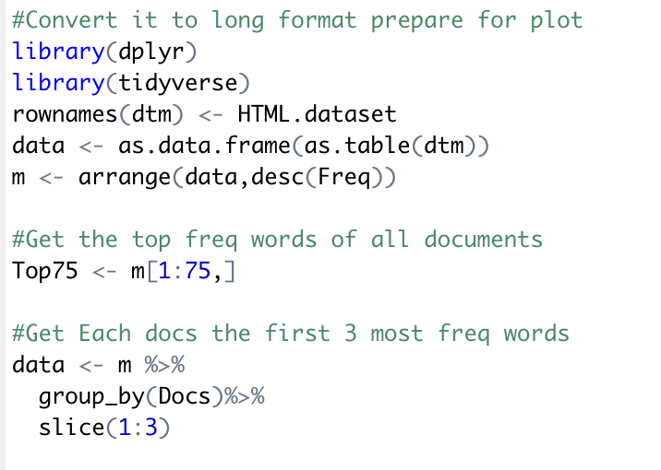

Slide 11
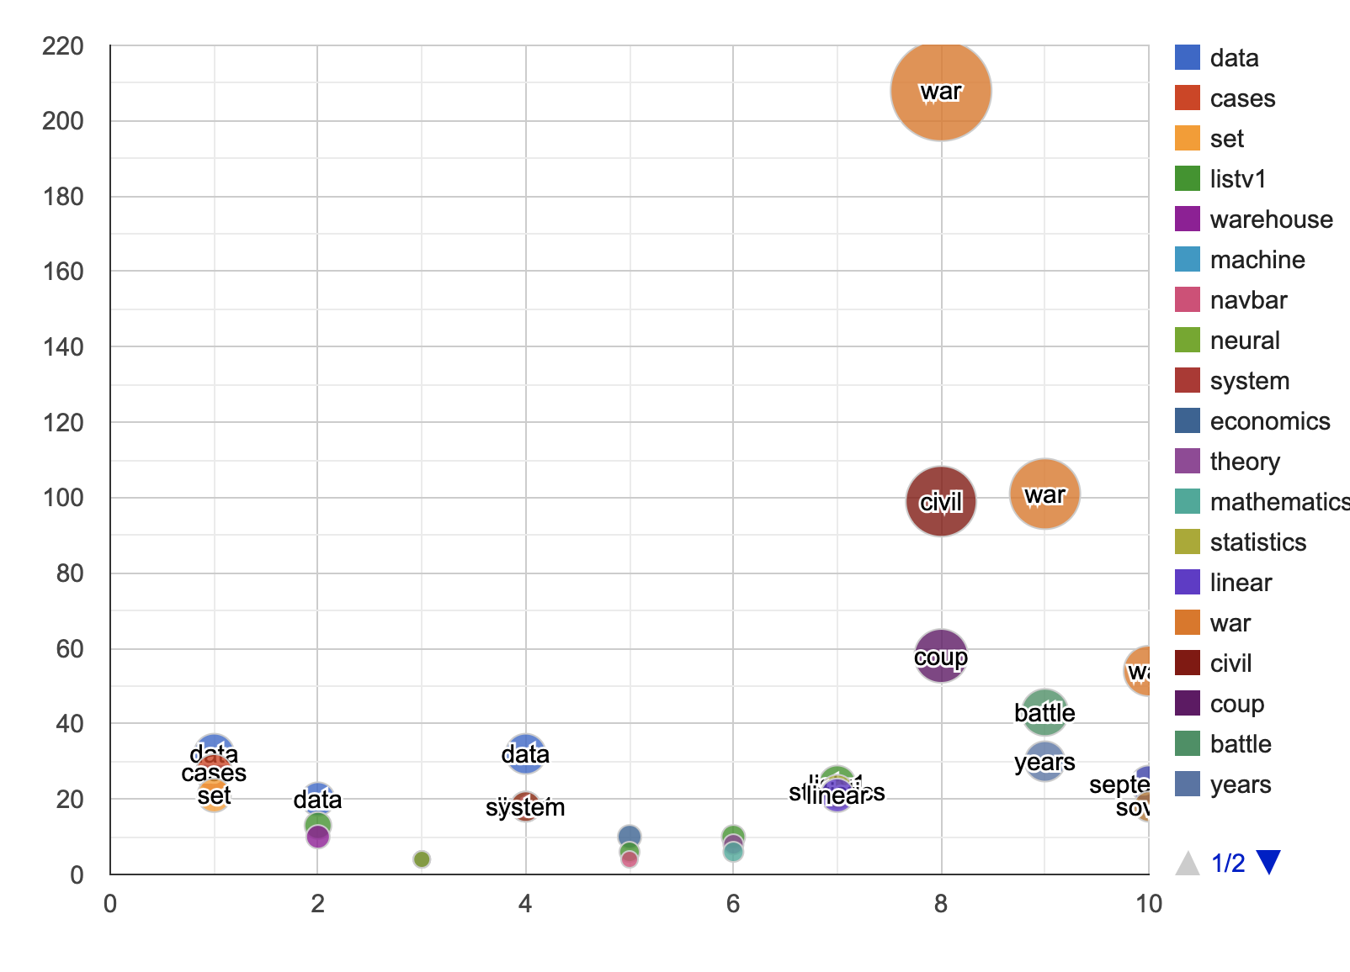
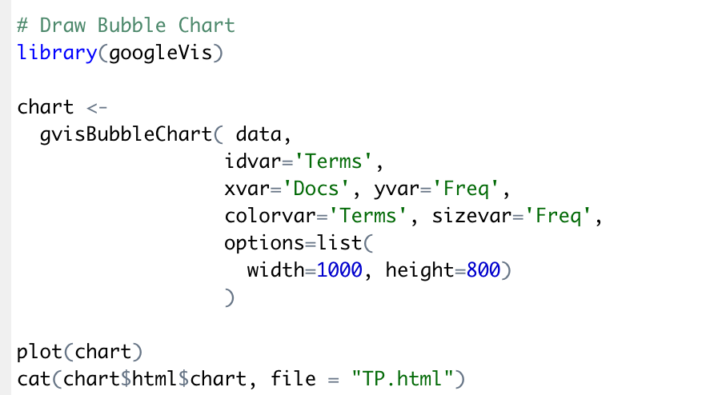
Bubble Chart

Slide 12
Thanks

